Slide 1

QTM (DSci) 151: Introduction to Statistical Computing II
Dr. Peter Sentz

Slide 2
Agenda
Introductions
CLASS DETAILS
COMPUTING Environment
Installation

Slide 3


About me
My name is Peter Sentz
Calling me “Peter” is fine
If you’re too scared to do that, “Prof. Sentz” or “Dr. Sentz” works as well.
Academic Background
Studied Mathematics (minoring in Economics) at University of Wisconsin-Milwaukee
Master’s degree in Applied Mathematics at University of Washington
PhD in Computer Science at University of Illinois Urbana-Champaign
Postdoc in Applied Mathematics at Brown University.
This is my first semester at Emory University
My daughter is two months old today!
My research background is in the numerical solution of differential equations and scientific machine learning.

Slide 4
Teaching Assistants
Molly Murphy (Section 1)
Shuyang Yu (Section 1)
Minh Bao Truong (Section 2)
Sarah Shao (Section 2)
They will be answering questions during our lectures and holding office hours (see Canvas for office hours information).

Slide 5
Agenda
Introductions
CLASS DETAILS
COMPUTING Environment
INSTALLATION

Slide 6
Learning Objectives
Learn how to code effectively in Python and SQL
Learn about key programming principles
Learn how to manipulate and visualize data
For more details and class schedule, review syllabus on course Canvas page!

Slide 7
Grades
Late submissions
Late assignments will automatically be graded for half-credit
To account for unforeseen circumstances, we will drop the worst assignment and the worst quiz
Watch out for the assignments to install software. You will need these to be able to use the lectures notes.
Assignments (x 10): 50%
Practice class concepts
Quizzes (x5): 30%
Questions are given in advance
Data is provided in the class
Final Project: 20 %
Will provide guidelines on Canvas
Due at the end of the semester
Midsemester Survey: + 0.5% (Extra)
Final Course Evaluations: + 0.5% (Extra)

Slide 8
Coding ability is not innate
Coding ability can be developed.
Academic skills and abilities are acquired through hard work, mistakes, and perseverance.
My only goal here is that you learn the material. Please ask me questions!

Slide 9
Questions about the logistics

Slide 10
Agenda
Introductions
CLASS DETAILS
COMPUTING Environment
INSTALLATION

Slide 11



Two components:
Virtual Environment
+
Python
VS Code
Integrated Development Environment (IDE)
(in background)
Programming language we use to write the instructions
The “front-end” software that you open every time you code something in Python
A “back-end” software that you install once and hardly open again.

Slide 12

We open script files in VSCode
VS Code Interactive Development Environment (IDE)
Environment where the user writes the scripts
Script File
File with code in the Python programming language.
Instructions for the program to follow

Slide 13


Lecture Notes
VS Code
Github:
A file management system in the cloud (with desktop app)
Has version control
Great for collaborative programming

Slide 14

Towards the end of the class we’ll also introduce SQL. - Advanced database language - Widely used in industry. - Can be connected to Python and uses very similar ideas. More details to come!
+
VS Code

Slide 15

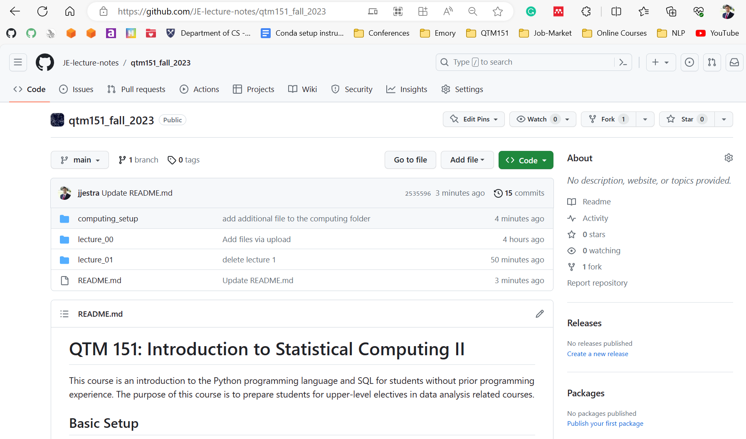
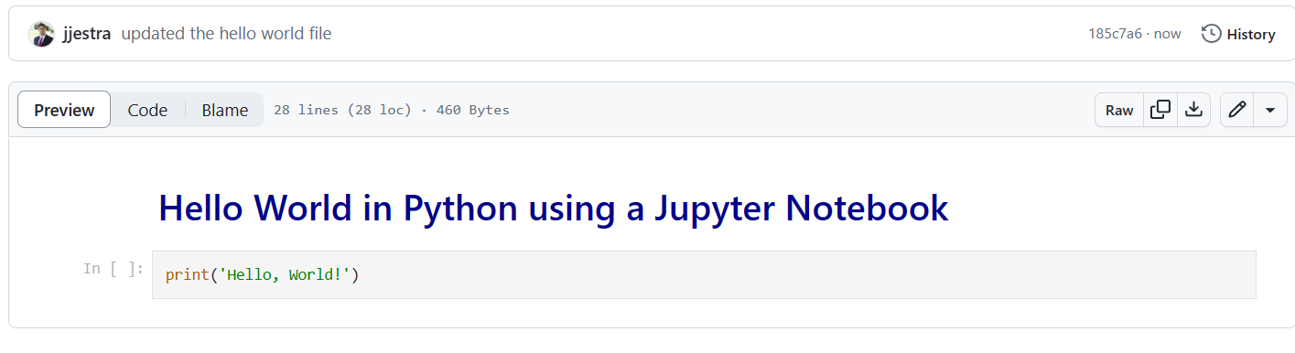
Lecture notes are publicly available at my GitHub website (link posted on Canvas):
https://github.com/sentz2/qtm151fall2025
You can view the lectures in the browser

Slide 16
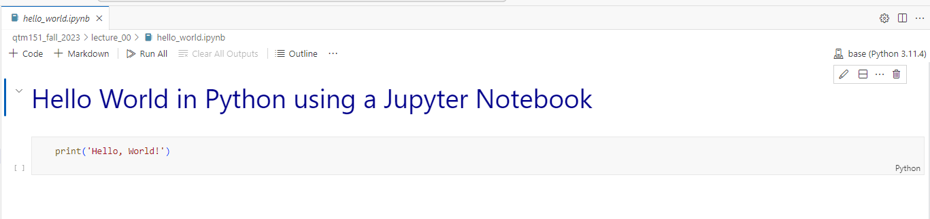
A Jupyter Notebook (“.ipynb”) is a file with code (python) and annotations (markdown)
All the lecture notes are written as Jupyter notebooks
It is encouraged that you bring your laptop to class
Lecture notes are designed to be follow-along. There will be “try it yourself” exercises.

Slide 17
VS Code
See Assignment 1
Basics of a Jupyter notebook
Need to have all the tools installed
Install soon that we can help you with any issues!

Slide 18

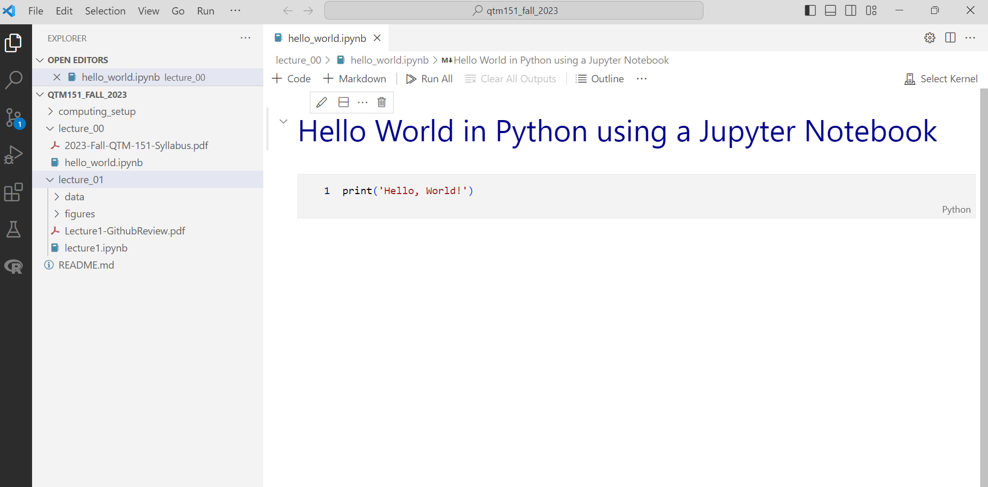
We will do all our coding in Visual Studio Code
Python
“.ipynb”: Interactive Python Notebook
Lecture notes

Slide 19
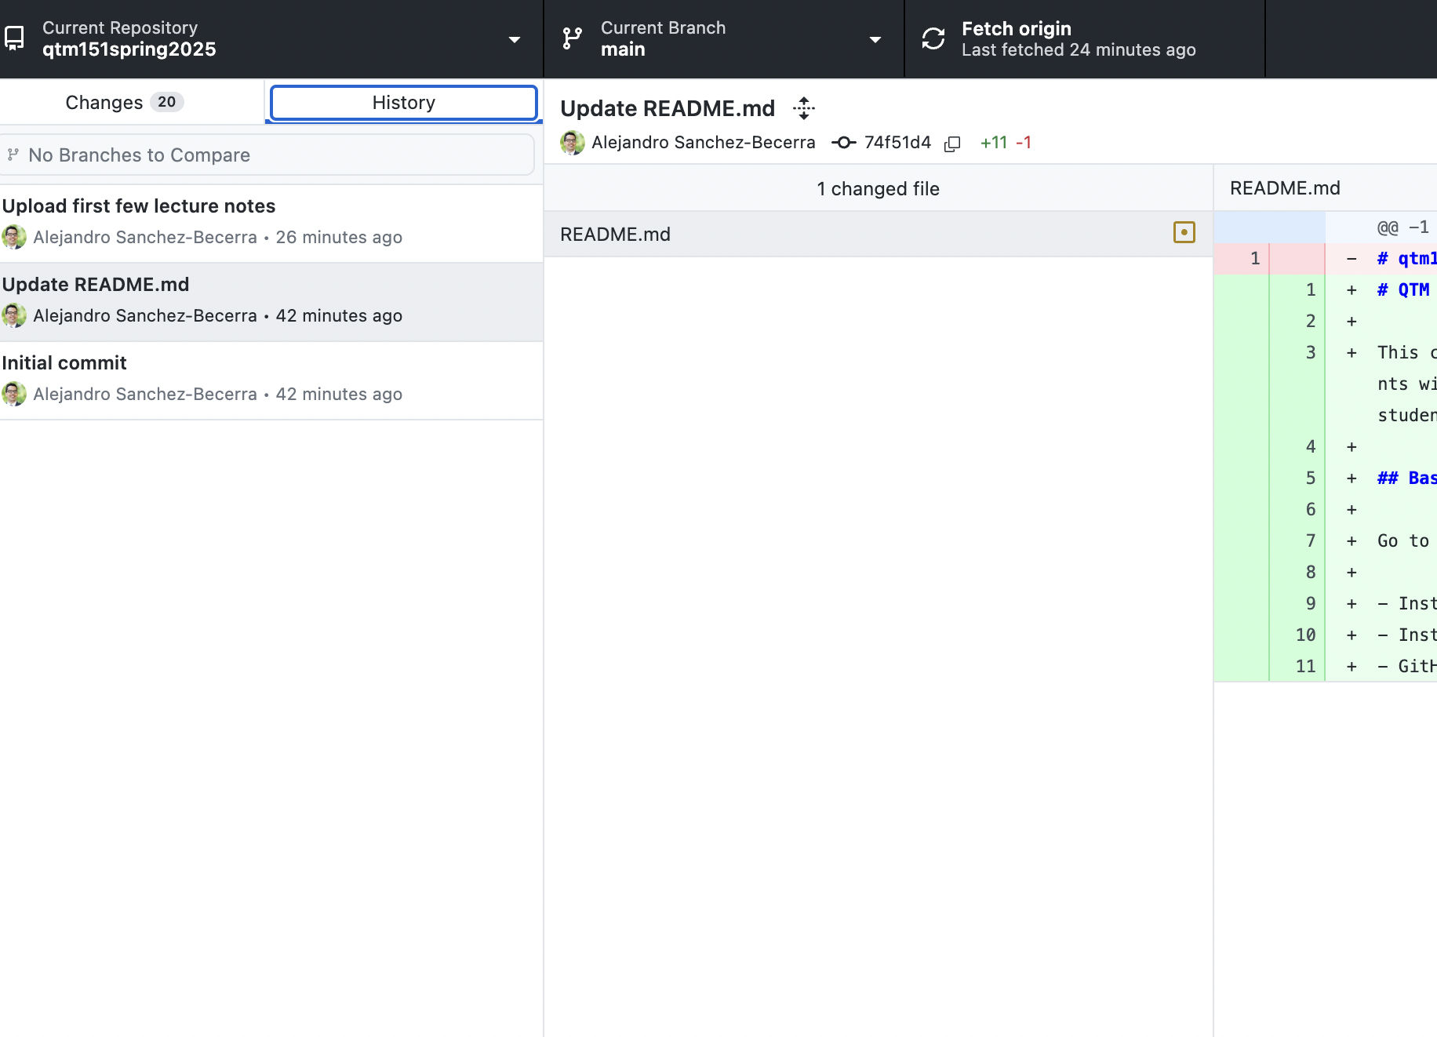
Github Desktop will allow you to automatically download the lectures notes from my account (and update them).
It will also show you
the date of any update
what the changes are
Update the lecture notes before class!

Slide 20
Questions about computing environment?

Slide 21
Agenda
Introductions
CLASS DETAILS
COMPUTING Environment
INSTALLATION

Slide 22
Let’s get started!
Go to “Modules” in Canvas and open the documents under “Installation” and follow instructions.
We will walk around to answer questions.
If you don’t complete the installation, we encourage you to visit one of the office hours, so that you are set up before the next class.

